Slide 1

EDA ON AMCAT DATA

Slide 2

About Me:
I am Sai Sujitha.
M.Sc. Biotechnology
As Data science is used in many Industries even in my stream of education so I choose data science.

Slide 3

Salary based on Gender, Specialization, Type of city and Designation.
Most common Degree and Background.
Maximum Employees based on city.
Designation Vs Salary
Is Gender impacts Specialization?

Slide 4

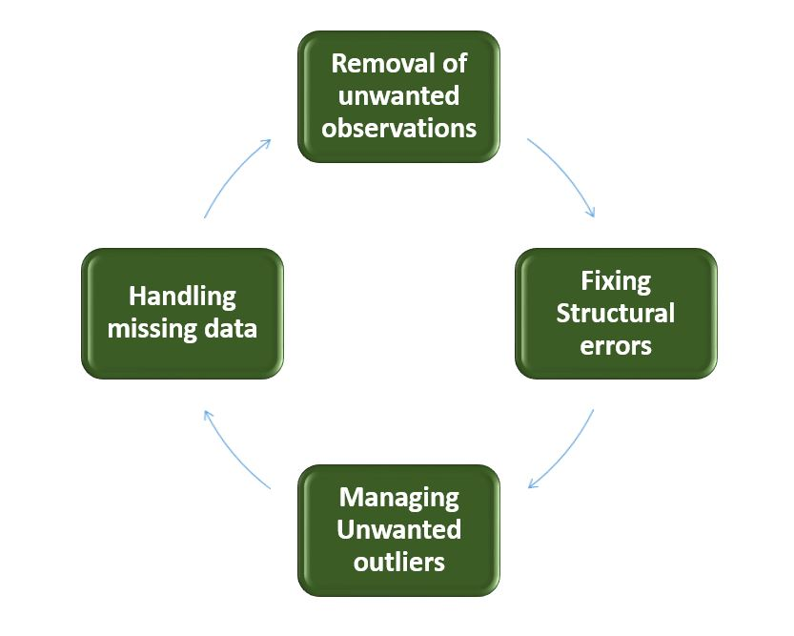
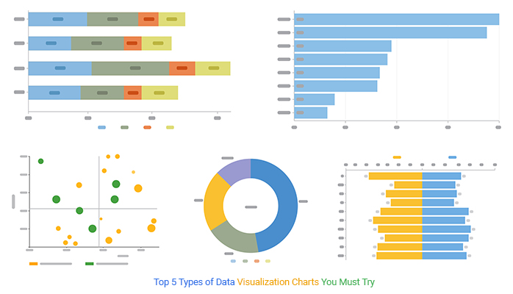
Exploratory Data Analysis
Steps Involved in EDA:
Data Collection Data Cleaning Data Visualization

Slide 5
Steps in Data Collection:
Importing Libraries Modules
NumPy and Pandas
Matplotlib and Seaborn.
Scipy

Slide 6
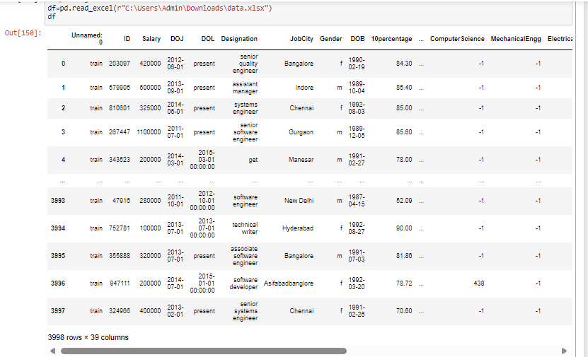
Extracted Raw Data Set

Slide 7
Data Cleaning

Slide 8
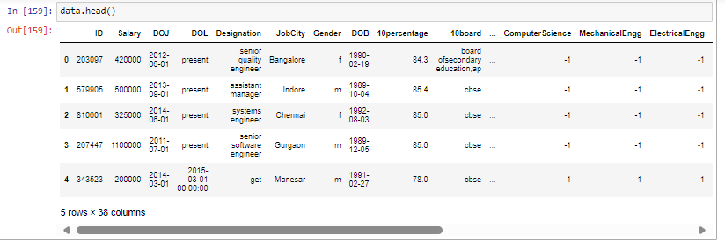
Removing Unnamed column

Slide 9
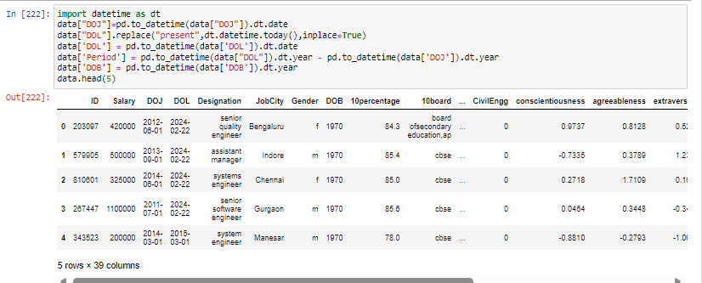
Converting timestamp into date

Slide 10
Data Visualization

Slide 11
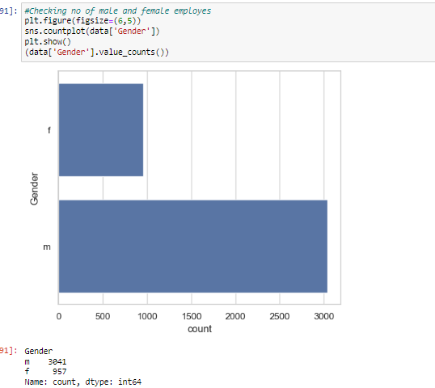
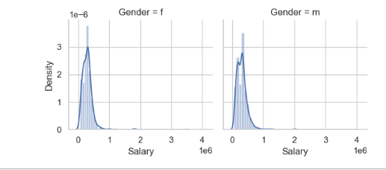
Objective 1 Salary based on Gender.
There is nearly a similar range of salary for both male and female.
According to the graph from the given data, Male employees are 3 times more than female employees.

Slide 12
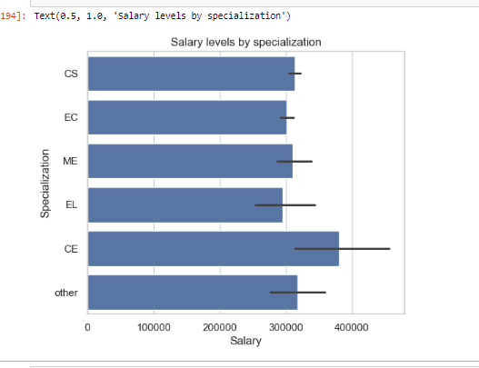
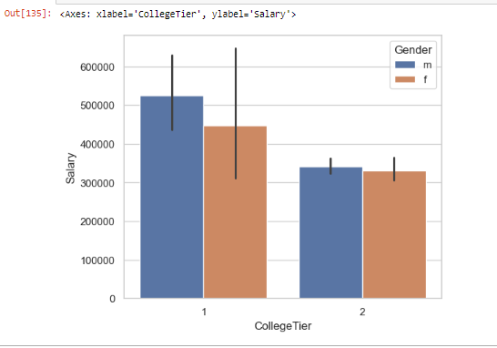
Objective 2: Salary based on Specialization, Type of city
CE getting Maximum salary and EL getting Minimum income compared to others.
tier1 colleges have higher salary,more men are from tier1 than women and overally are from tier2 colleges.

Slide 13
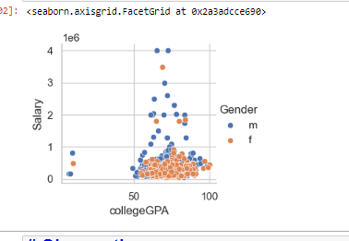
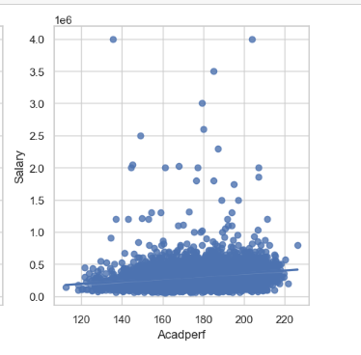
Objective 3: GPA, Academic Performance
Most of men and women have CGPA around 70-75 which is a good range.

Slide 14
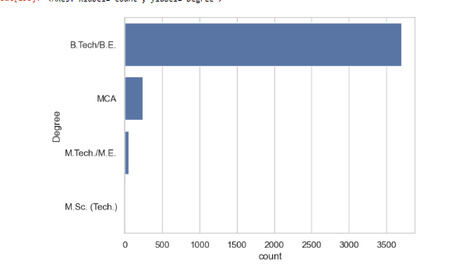
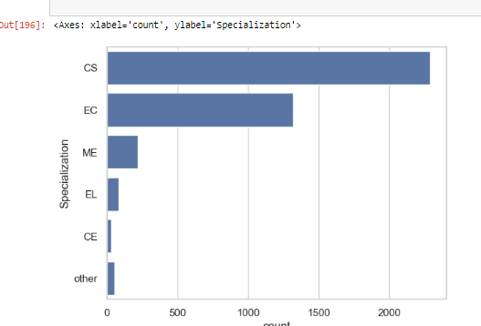
Objective 4: Most Common Degree And Background
Most of the employees are from B. Tech and B.E
Most of the employees are from CS background

Slide 15
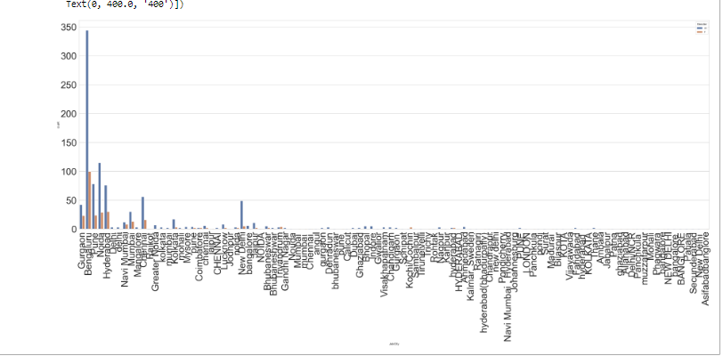
Objective 5: Maximum Employees from City
Most of them working in Bengaluru,Noida,Hyderabad and Pune because most of them are from IT.

Slide 16
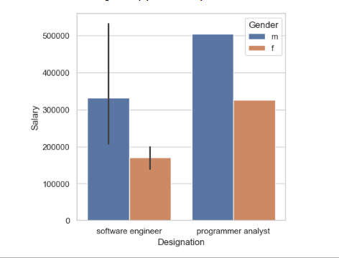
Designation Impact Salary? No

Slide 17
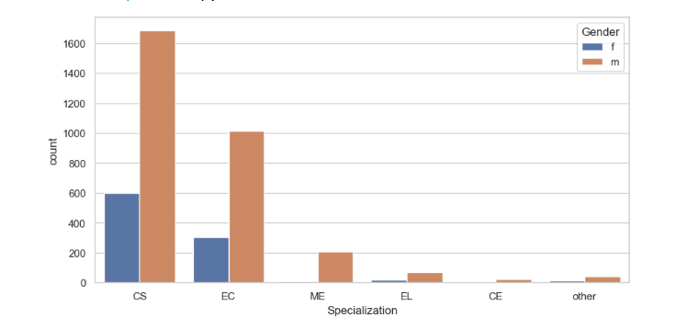
Gender Impacts Specialization? Yes

Slide 18


